Slide 1
Recommender System
Assignment 2 group Recommendations

Slide 2
The basics
For Data Preparation:
Solution used Pandans and Python
Reshape the data to be group by userId
Create ratings columns for each movieId
For Similar Users:
Only consider users with at least 4 common rated movies
Pearson correlation done using Scipy
Use threshold of 0.7 for similar user
For Finding Best Movie For User:
Predict user rating for each movie in the dataset
Return movies with highest predicted ratings

Slide 3
Group recommendation with MEAN and Min aggregation
Predict the movie rating for each movie and for each user
Take Mean/Min of the group users rating for each movie
If rating prediction is not possible, set the rating as 2.5
Take the movies with the highest predicted group ratings

Slide 4
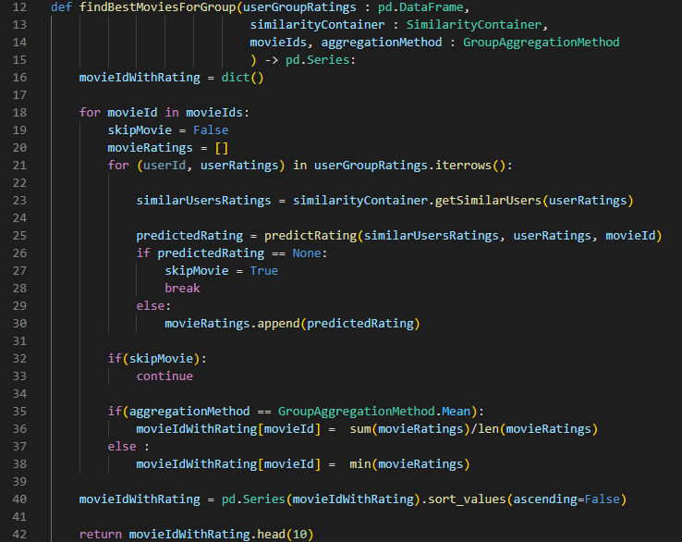
Group recommendation with MEAN and Min aggregation

Slide 5
Group recommendation with disagreements Using Borda method
Predict the movie rating for each movie and for each user
If rating prediction is not possible, set the rating as 2.5
Rank the ratings for every movie and for each user
Sum the users rating in a group for each movie
Take the movies with the highest sum value

Slide 6
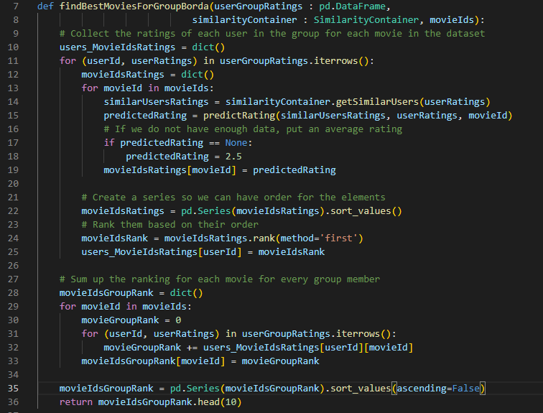
Group recommendation with borda count method

Slide 7
Thanks

